Slide 1

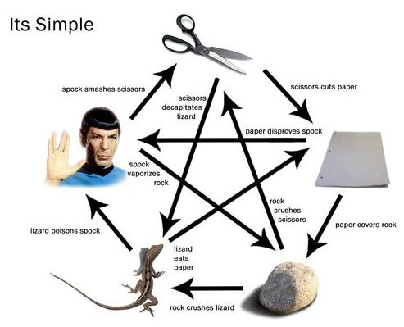
Multiplayer R.P.S.L.S.
R-Rock
P-PAPER
S-SCISSORS by Daniela Lujan
L-LIZARD Katya Torres
S-SPOCK

Slide 2

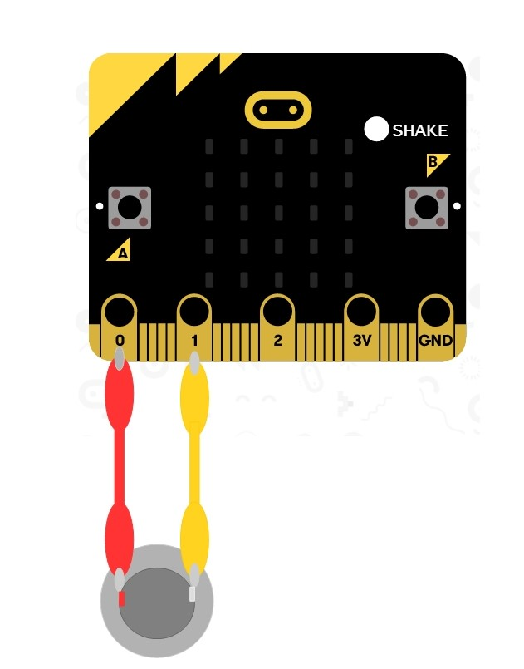
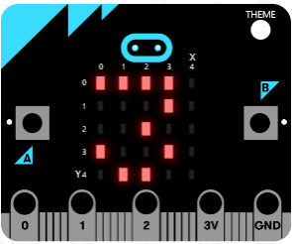
Counter, clear Winner, speaker

Slide 3
Game Demonstration

